Slide 1
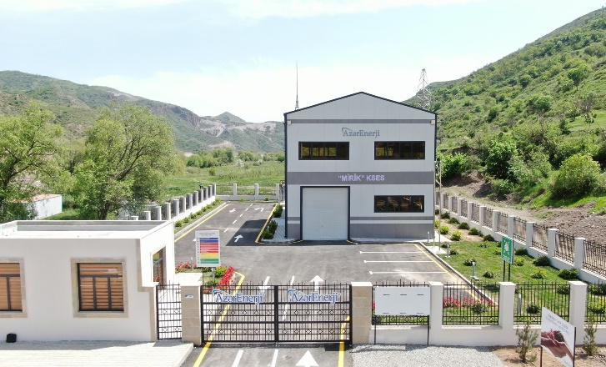
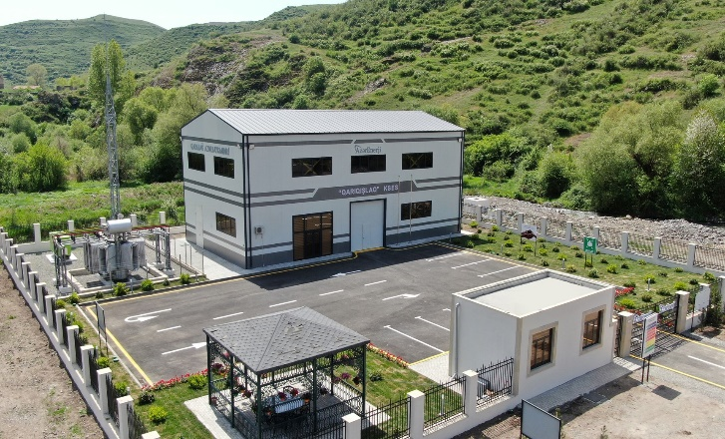
GS12624 STAKEHOLDER CONSULTATION MEETING OF MIRIK AND GARIGISHLAG HYROPOWER PLANTS
15 April 2025, 14.00
https://registry.goldstandard.org/projects/details/4512

Slide 2
Agenda
Aim of the Meeting
Introduction of the Project
Sustainable Development Goals (SDGs)
Questions & Answers
Continuous Feedback Mechanism
Sustainable Development Assessment
Evaluation Forms
Stakeholder Feedback Round
Closing

Slide 3
1. Aim of the Meeting
to identify, engage and consult stakeholders to improve project outcomes
to inform stakeholders about the project and discuss its likely impacts
to establish an ongoing engagement process for stakeholders to provide input, feedback and to raise concerns throughout the project life

Slide 4
2. Introduction of the Project
Registration by Gold Standard
Gold Standard is an internationally recognized certification standard for carbon offset projects and sustainability initiatives.
Established by the World Wildlife Fund (WWF) and other environmental organizations.
Criteria
Reducing carbon emissions: Projects must contribute to the reduction of global greenhouse gas (GHG) emissions.
Sustainable development: Projects must create positive social, economic, and environmental impacts
Transparency and accountability: Projects must involve thorough monitoring, reporting, and independent verification

Slide 5
2. Introduction of the Project
Mirik Hydropower Plant
Garigishlag Hydropower Plant
Location: Zabukh river in Lachin District, Baku Province

Slide 6
2. Introduction of the Project
Transformer
Transformation Center
Metering Devices
Turbines and Generators
Azerbaijan National Electricity Grid
Reservoirs

Slide 7
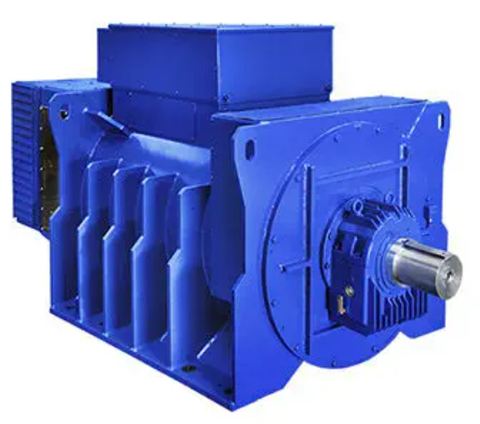
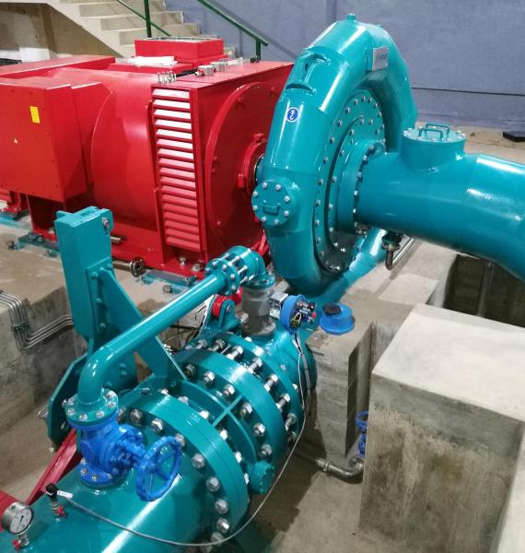
2. Introduction of the Project
Generator
Marelli Motori Generator
Manufactured in 2023
Turbine
Gugler Francis Turbine
Manufactured in 2023

Slide 8
2. Introduction of the Project
Milestones of the Project
15 Dec. 2023
Land Permit of Mirik Hydropower Plant
25 Dec. 2023
Land Permit of Garigishlag Hydropower Plant
27 Mar. 2024
Commissioning of Mirik Hydropower Plant
28 Mar. 2024
Commissioning of Garigishlag Hydropower Plant
15 Apr. 2025
Stakeholder Consultation Meeting

Slide 9
2. Introduction of the Project
 | Mirik HPP | Garigishlag HPP
Capacity | 3.3 MW | 3.8 MW
Scale | Small scale | Small scale
Electricity Generation | 9,500 MWh per year | 11,000 MWh per year
 | Power for 2,870 homes per year | Power for 3,320 homes per year
Greenhouse Gas Emission Reduction | 3,860 tons of carbon dioxide (CO₂) | 4,450 tons of carbon dioxide (CO₂)

Slide 10
2. Introduction of the Project
Direct Benefits of the Project:
Contributing to the national economy by generating electricity from renewable sources (hydropower)
Reduces energy imports and increases national self-sufficiency
Reducing greenhouse gas emissions
Reducing use of fossil fuels and dependence on fossil fuels
Creating employment in the region

Slide 11
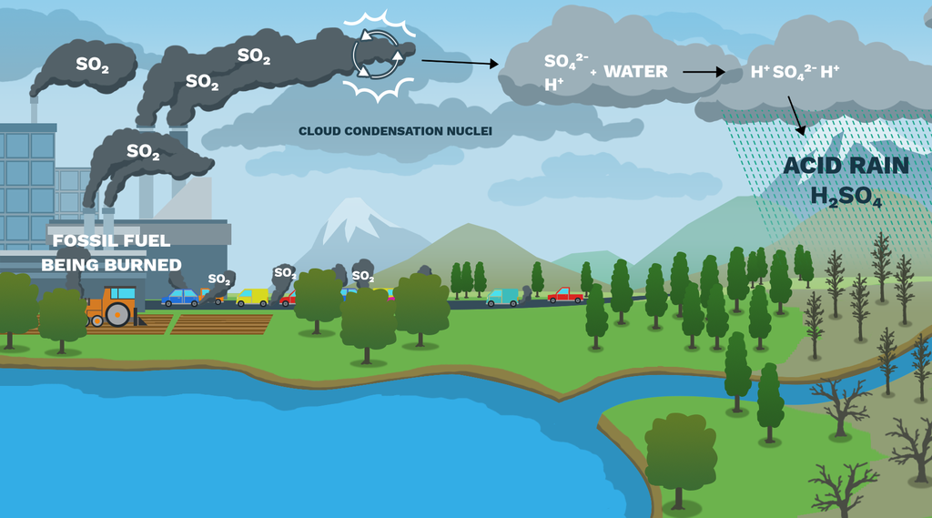
2. Introduction of the Project
Indirect Benefits of the Project:
Prevention of groundwater pollution
Prevention of air pollution
Decrease the overall environmental impact of energy generation

Slide 12
2. Introduction of the Project
Potential Adverse Risks of the Project
Does the project have a risk of increasing greenhouse gas emissions?
No, on the contrary, the Project decreases GHG emissions by generating clean energy therefore decreasing usage of fossil fuels for electricity generation.
Does the project pose a risk to the availability and reliability of energy supply to other users?
No, the Project generates electricity from clean energy sources and enhances the reliability of the national electricity supply.
Does the project involve risk of release of hazardous materials resulting from their production, transportation, handling, storage, or use?
All wastes are handled according to the laws and regulations in Azerbaijan.

Slide 13
2. Introduction of the Project
Potential Adverse Risks of the Project
Does the project increase water usage to a level that will not allow for the maintenance of environmental flows?
In order to ensure the stability of the flow along the river course for the migration of fish and other bioresources, sanitary flow is maintained. If the water level in the river is decreased to a certain level, operation of the power plants are stopped.
Does the project involve any risks to animal welfare?
There are fish conveyors that provide safe passage to fish from upstream to downstream. Also, in order to ensure the stability of the flow along the river course for the migration of fish and other bioresources, sanitary flow is maintained. Therefore, the risk is minimized.

Slide 14
3. Sustainable Development Goals (SDGs)
The SDGs are a set of 17 global goals created by the United Nations in 2015, with a simple but powerful mission:
‘To make life better for people, and to protect the planet, by the year 2030.’

Slide 15
3. Sustainable Development Goals (SDGs)
SDG 7 – Affordable and Clean Energy
Goal: Ensure access to affordable, reliable, sustainable, and modern energy for all
How our hydropower plants contribute:
Generating clean, renewable electricity from water.
Reducing reliance on polluting fossil fuels like diesel or coal.
Expanding access to affordable power for homes, businesses, and public services.

Slide 16
3. Sustainable Development Goals (SDGs)
SDG 8 – Decent Work and Economic Growth
Goal: Promote sustained, inclusive economic growth, and decent work for all.
How our hydropower plants contribute:
Creating local jobs during construction and ongoing operations.
Offering skills training and career growth opportunities.

Slide 17
3. Sustainable Development Goals (SDGs)
SDG 13 – Climate Action
Goal: Take urgent action to combat climate change and its impacts.
How our hydropower plants contribute:
Producing low-carbon energy, reducing greenhouse gas emissions.
Supporting the shift to a sustainable, climate-resilient future.
Raising community awareness on climate-friendly practices.

Slide 18
4. Questions & Answers

Slide 19
5. Continuous Feedback Mechanism
Aim: Reporting, resolving, and monitoring any issues that may arise during the operation period.
Please contact us if you have any inputs or grievances during the operation period via
E-mail: info@azerenerji.gov.az
Telephone: +994 12 5985523
Expression Process Book Location: 10 Ac. Abdulkarim Alizadeh str. Baku, Azerbaijan

Slide 20
6. Sustainable Development Assessment - Environmental
Sustainable Development Indicators | Participant Comments
 | Positive | Negative | No Effect
Air quality (Sulfur dioxide, nitrogen oxides, soot, etc.)
Water quality and quantity (Access to water resources)
Soil quality (Fight against erosion, soil pollution, etc.)
Other pollution sources (noise, light, etc. pollution sources)
Biodiversity (Effect on protected species)

Slide 21
6. Sustainable Development Assessment - Social
Sustainable Development Indicators | Participant Comments
 | Positive | Negative | No Effect
Employment Quality (Working conditions, job security)
Combating Poverty (Impact on standard of living, access to health services, etc.)
Personal and institutional capacity (Education, awareness raising)
Contribution to employment and income level (New job opportunity, income increase)

Slide 22
6. Sustainable Development Assessment - Economical
Sustainable Development Indicators | Participant Comments
 | Positive | Negative | No Effect
Access to clean energy sources (Reliable, cheap energy, impact on energy imports)
Balance of Payments (Reducing foreign dependency, increasing investment)
Technology transfer and technological competence (Using, adapting, etc.)

Slide 23
7. Evaluation Forms
Please write your comments and suggestions about the project.
Layihə haqqında nəyi müsbət hesab edirsiniz? / What are the aspects that you find positive about the project?
Layihə ilə bağlı nəyi mənfi hesab edirsiniz? / What are the aspects that you find negative about the project?

Slide 24
8. Stakeholder Feedback Round
Project documents can be accessed via https://registry.goldstandard.org/projects/details/4512
The project will be open for further comments for 30 days after the meeting.

Slide 25
9. Closing
Thank you for participating and sharing your comments about the Project. Please contact us if you have any inputs via
E-mail:
info@azerenerji.gov.az
Telephone:
+994 12 5985523
Webpage:
www.azerenerji.gov.az

